Slide 1
PoveR-T Test Feature Selection and classification
William T. Bickelmann

Slide 2
Background
World Bank is an international financial institution that develops poverty reduction strategies and goals
In collaboration; Driven Data released a data analysis competition to predict poverty at household level
Log-loss is performance metric
According to UNICEF, 22,000 children die each day due to poverty

Slide 3
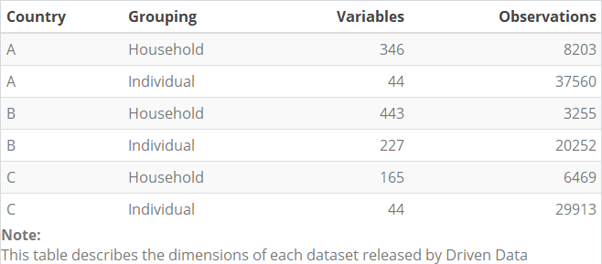
The data
6 Datasets; 2 for each country

Slide 4
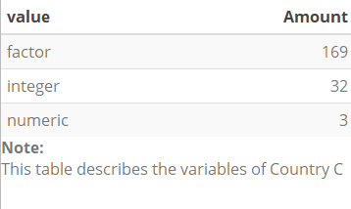

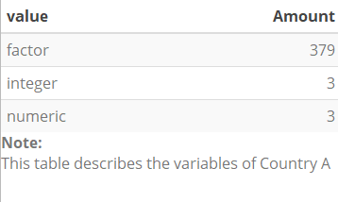
The data CONT’D
Majority of data consists of random strings which are factor variables
Example: "mNrEOmgq" "PWShFLnY“
Over half of each dataset not in poverty at household level

Slide 5
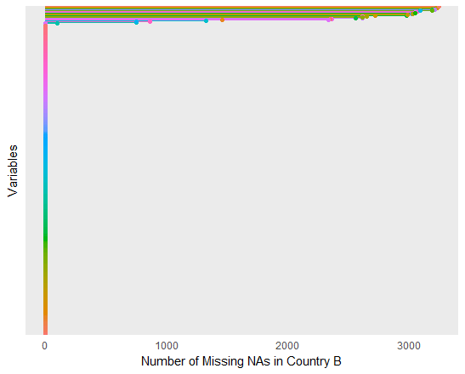
Data Preprocessing
Data needed to be joined and duplicates eliminated from individual set
Missing data was addressed by removing variables with high number of missing values
Factor variables with excessive levels cause errors and required removal

Slide 6
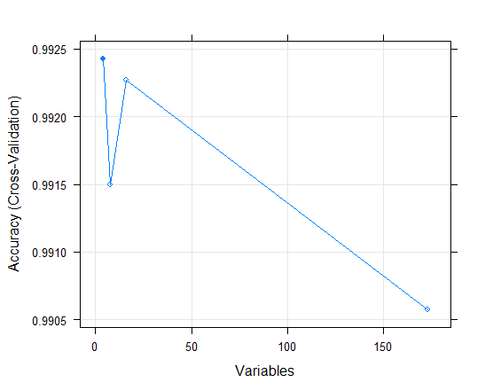
Feature Engineering
Near Zero Variance predictors removed as they add no predictive power
Recursive Feature Engineering used on Country C (rfe)
Simulated annealing feature selection used on Countries A and B (safa)
By end of feature engineering:
Country A had 66 variables
Country B had 147 variables
Country C had 5 variables

Slide 7
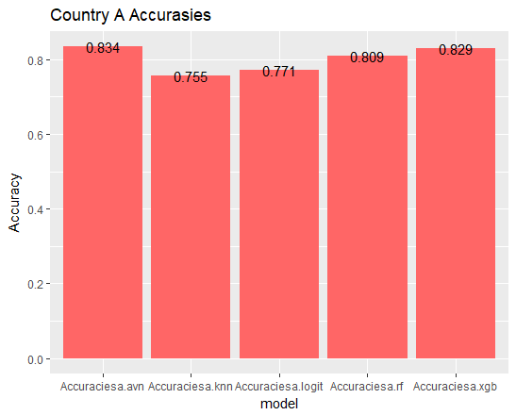
Results: Country A
Country A had 53 percent no-information rate
Caret’s ‘avNNet’ (Neural Networks Using Model Averaging) had highest accuracy

Slide 8
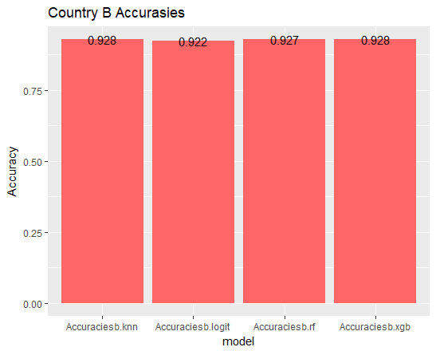
Results: Country B
Country B had 96 percent no information rate
XGBoost had highest accuracy at 92 percent

Slide 9
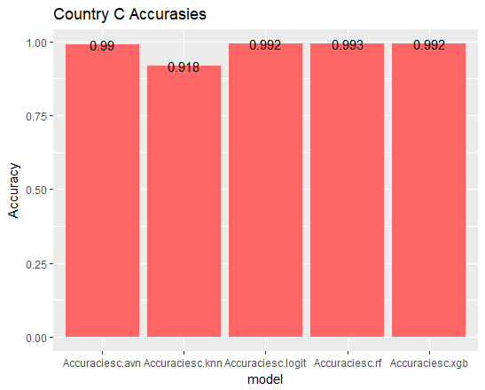
Results: Country C
Country C had 85 percent no-information rate
Random Forest had highest accuracy with 99.3 percent accuracy

Slide 10
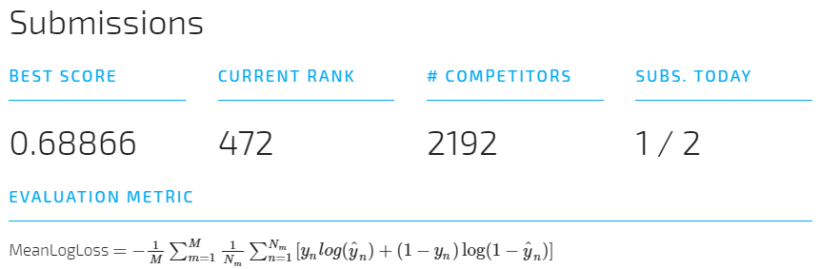
Competition Results
The displayed result was achieved by predicting probabilities using random Forest
Log loss was success metric
Predictions were weighed against true probabilities (never given to analysts)

